Slide 1
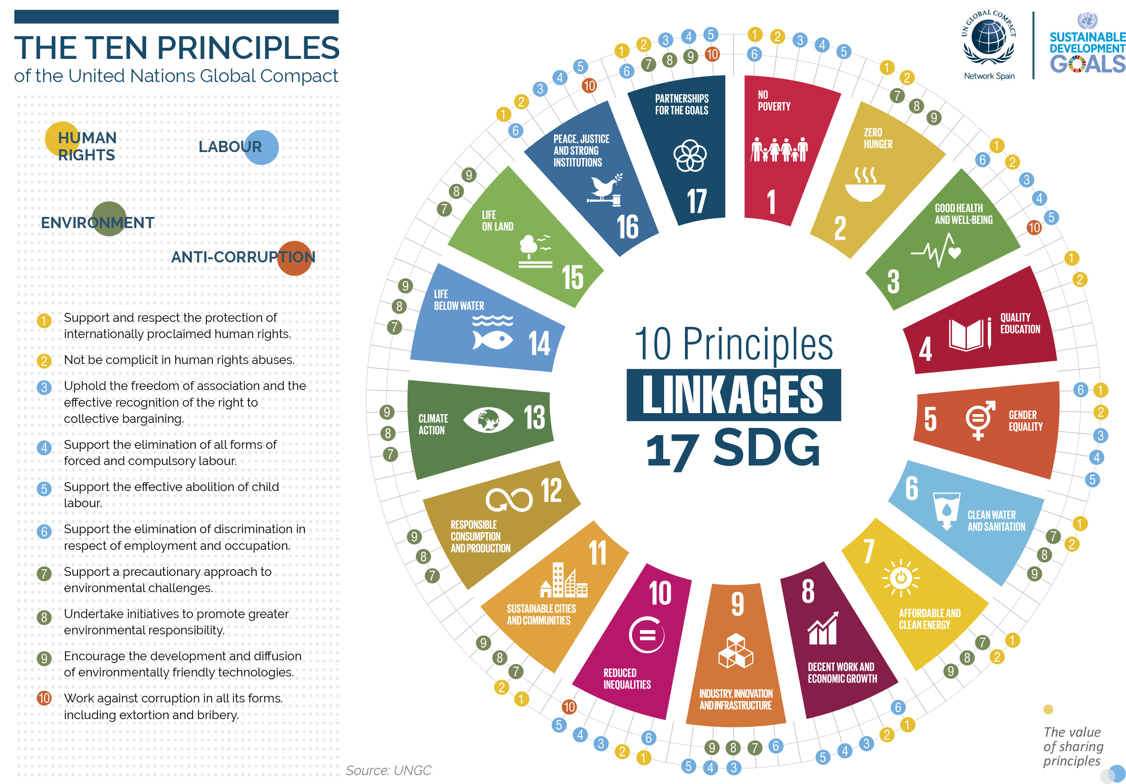
Triple bottom line strategy
People
Planet
Profit
LUX* Corp. Sustainability Management Plan
Corporate Governance
Code Of Conduct & Ethics
LUX*
Sustainability
Policy
LUX*
Whistle
Blowing
Policy
LUX*
Equal
Opportunity
Policy
LUX* Corporate Policies
Sustainability Policy
Environmental Policy
Human Rights Policy
Equal Opportunity Policy
Health & Safety Policy
Corporate Social Responsibility Policy
Whistleblowing Policy
Child Protection Policy
Purchasing Policy
+ Anti-Bribery Annex
LUX*
Child
Protection
Policy
LUX*
Corp.
Social
Resp.
Policy
LUX*
Purchasing
Anti-bribery
Policy
LUX*
Human
Rights
Policy
LUX*
Environmental
Policy
LUX*
Health & Safety
Policy
https://www.luxresorts.com/en/about-us/investor-relations/corporate-governance/sustainability-csr#accordion-1
https://www.luxresorts.com/media/5232/lux_sustainability_policy.pdf
https://www.luxresorts.com/media/5229/lux_csr_policy.pdf
https://www.luxresorts.com/media/5230/lux_environmental_policy.pdf
https://www.luxresorts.com/media/5231/lux_purchasing_policy.pdf
https://www.luxresorts.com/media/5228/lux_child_protection_policy.pdf
https://www.luxresorts.com/media/4903/lux-scsr-vision-2020.pdf

